Slide 1
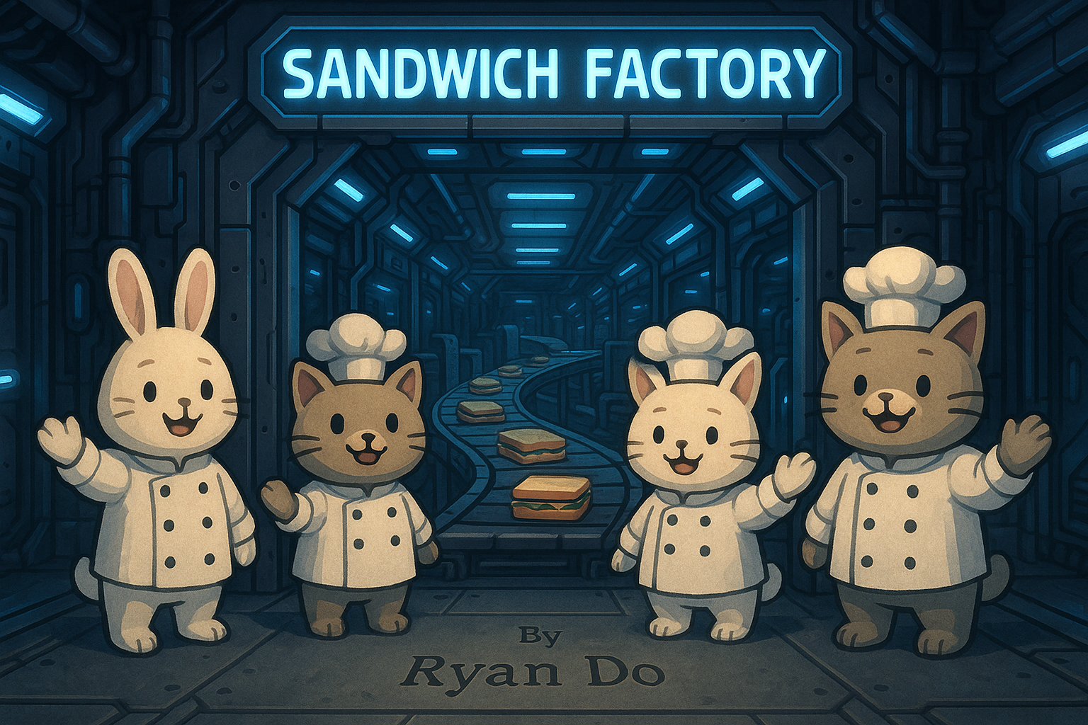

Slide 2

Project Overview
- Manual sandwich orders
- Fully customizable sandwiches
- Generates digital receipts
- UML class diagram

Slide 3
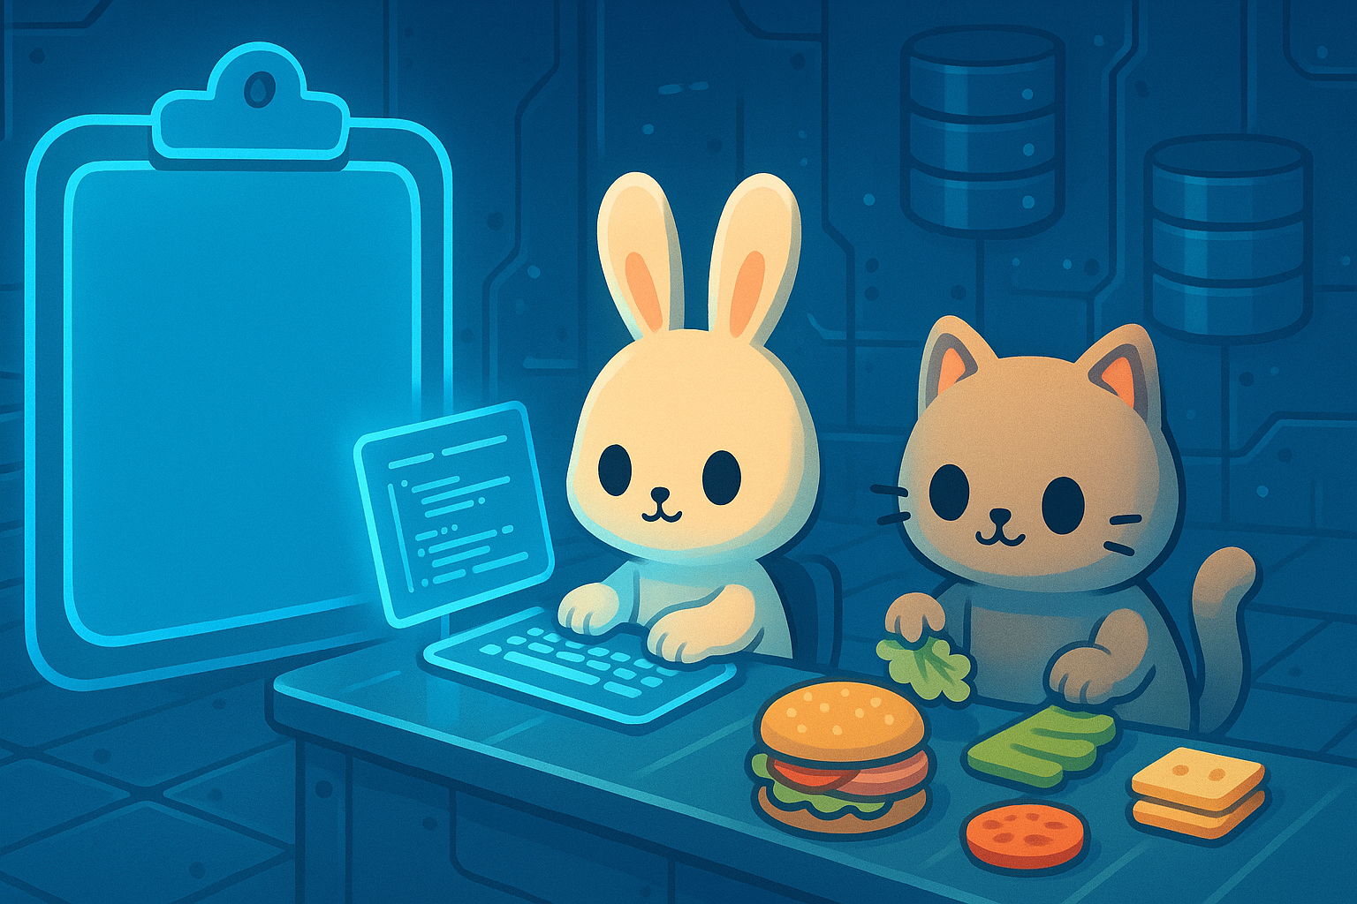
Key Features
-Interactive menu that handles: -Sandwich
-Chips
-Drinks
- List of fully editable preset signature sandwiches as templates
-Pricing based on size and
extra premium toppings
-Saves receipt files named by timestamp

Slide 4
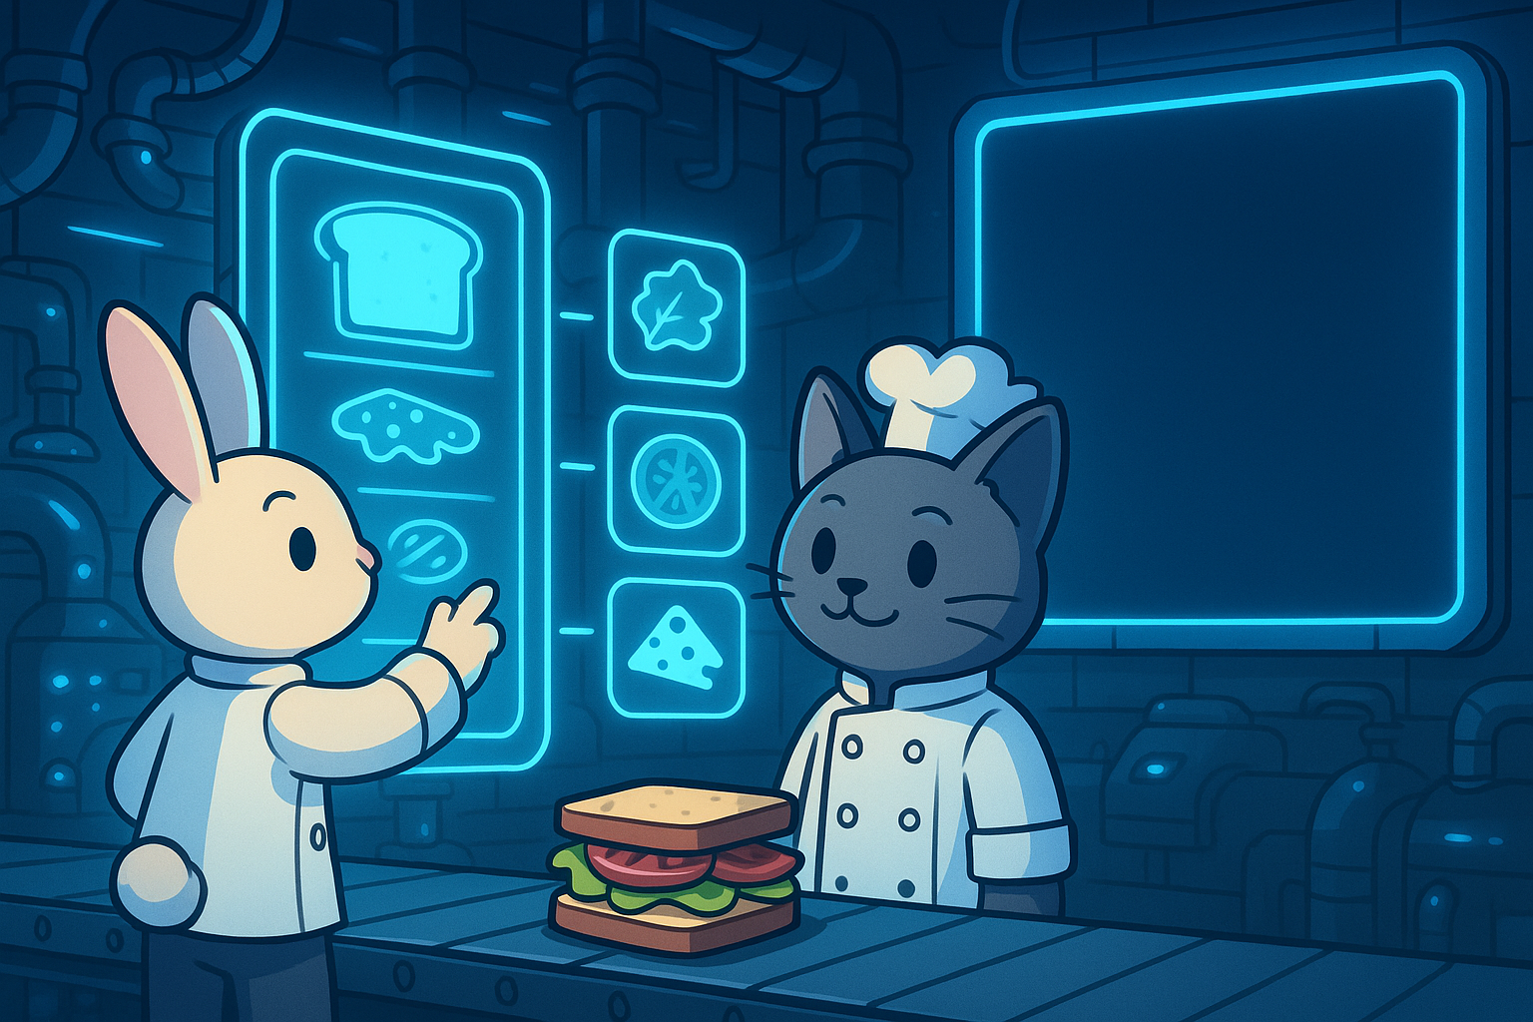
Cool Design Highlights
-Built with Object-Oriented Programming concepts
-Enums for bread types, sizes, and toppings categories
-List of enums to keep track of where customer is in the sandwich building process
-Some Unit tests

Slide 5


